Slide 1
Unity Tutorial: Game HUD UI
Armandas Abramavičius

Slide 2
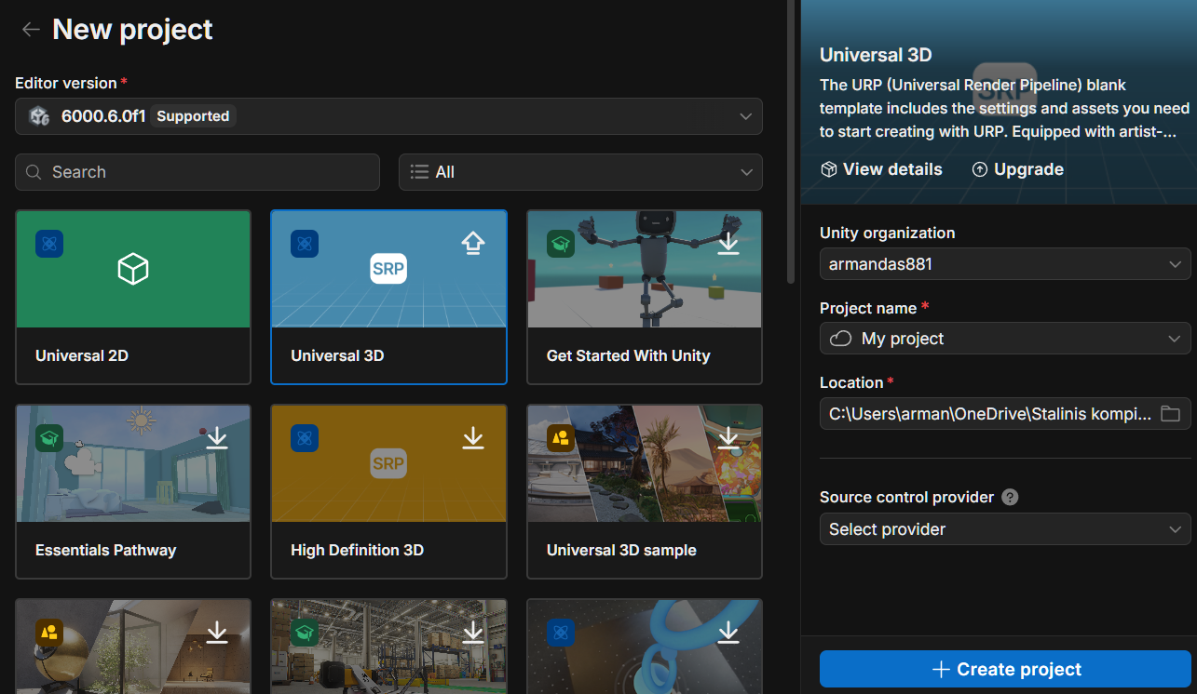
Step: 0 – creating a project
Create a new Project
(Universal 3D)

Slide 3
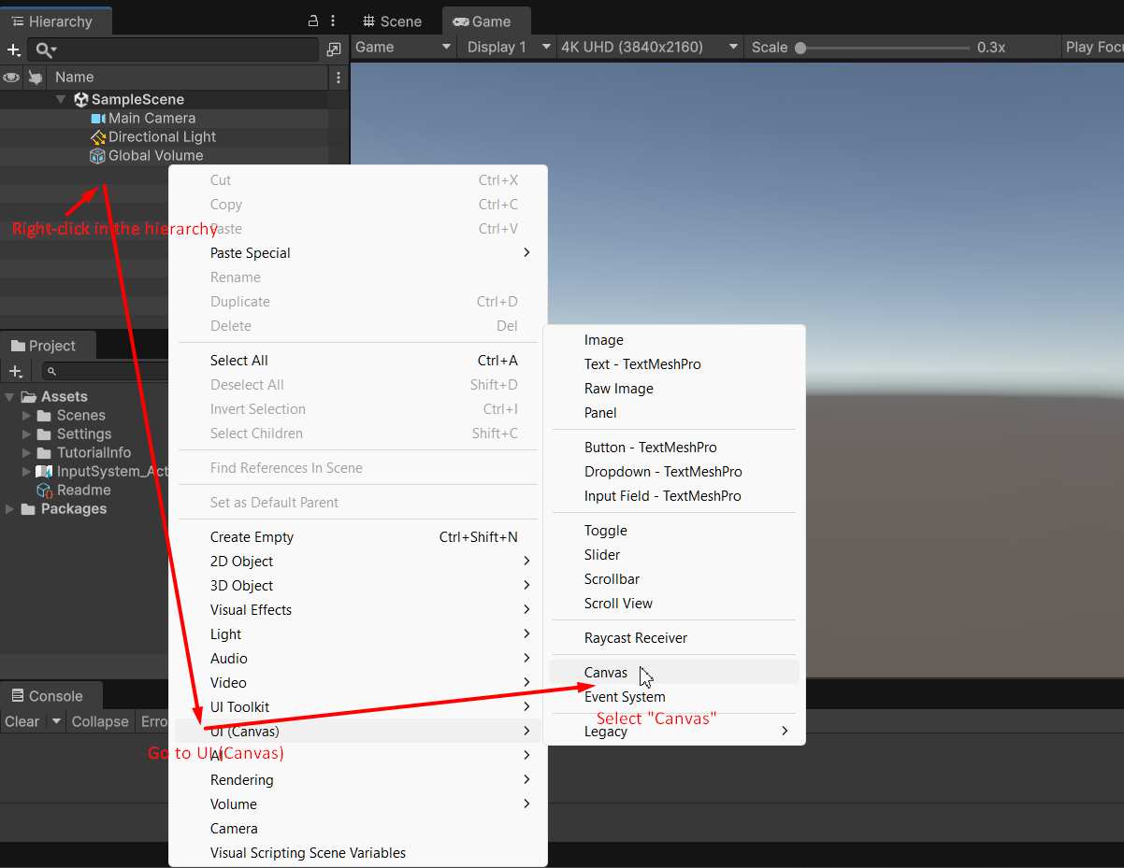
Step: 1 – Add a canvas in the scene
1. Right-click in the hierarchy
2. Select UI (Canvas)
3. Select Canvas

Slide 4
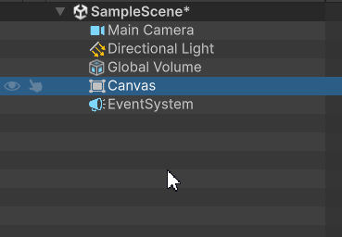
Now you have a Canvas in the Hierarchy which also adds the event system automatically.
The event system is used to process user inputs such as clicks, touches or key presses.
Canvas acts as a container that holds all the user interface elements.

Slide 5
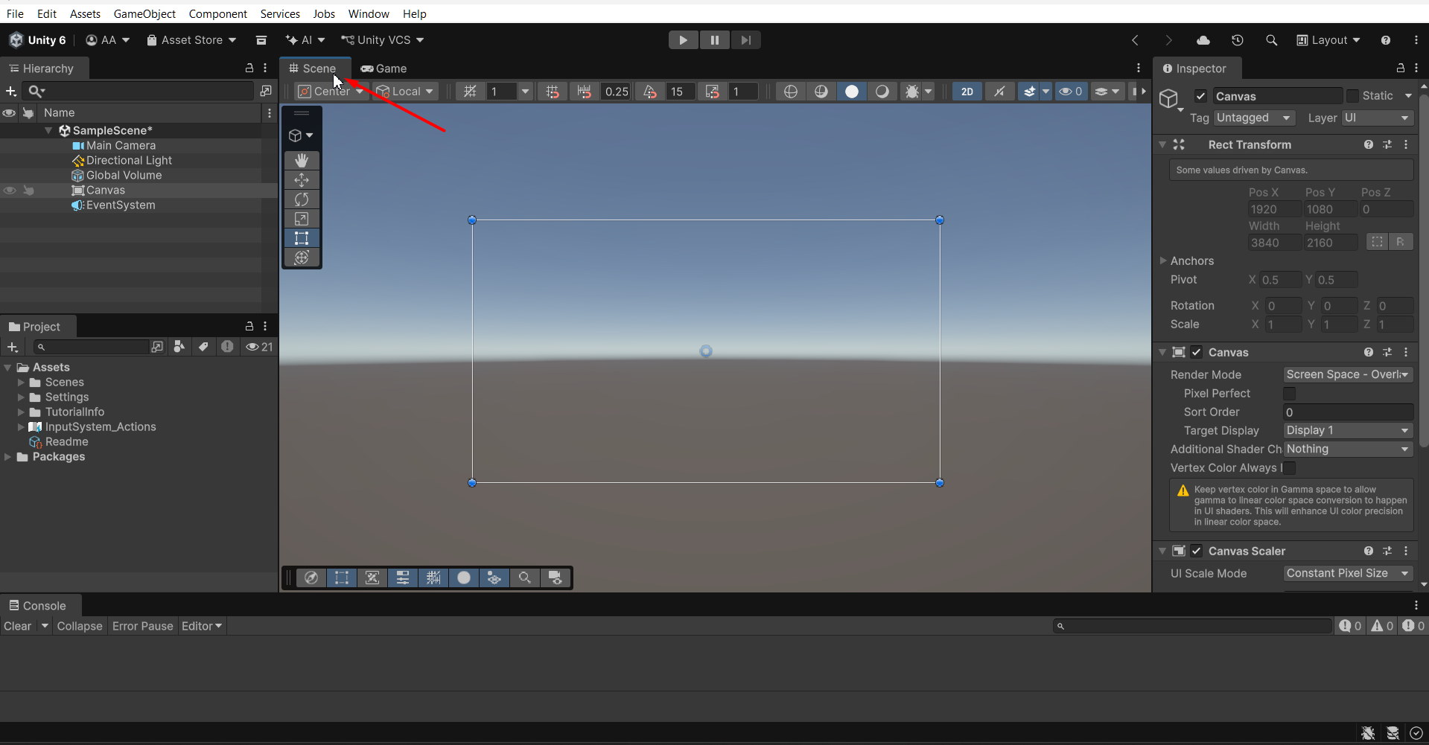
Step: 2 – Adjust scene & camera
1. Click on #Scene
2. Select Canvas in Hierarchy
3. Press “2” on keyboard so the camera positions to the canvas in a 2D view.

Slide 6
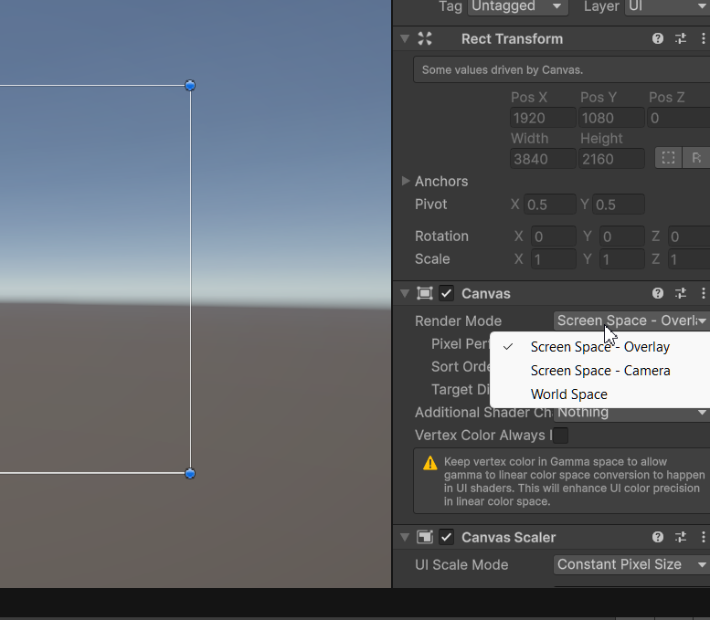
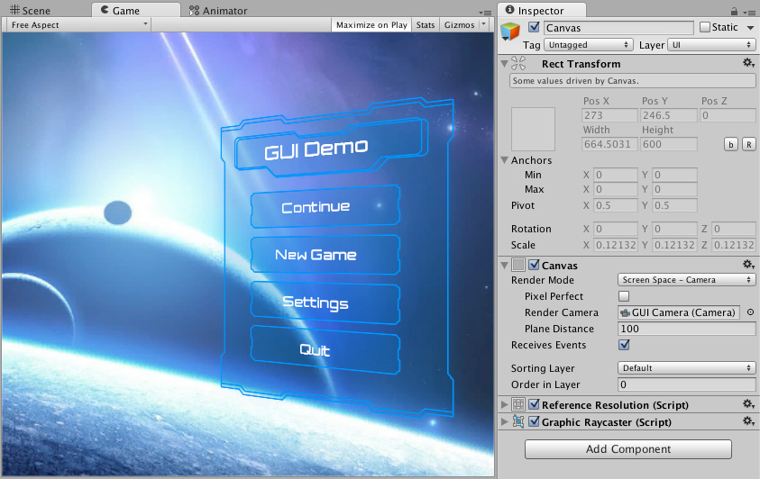
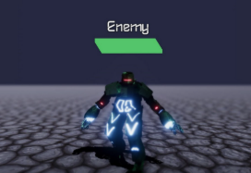
Canvas properties
Canvas has three render modes:
Screen Space – Overlay: it is the default render mode which draws UI elements on top of everything else in the scene;
Screen Space – Camera: it’s a render mode that places the UI plane a specific distance in front of a designated camera
World Space – this render mode places the UI elements in the world space (ex: a name tag above the player)

Slide 7
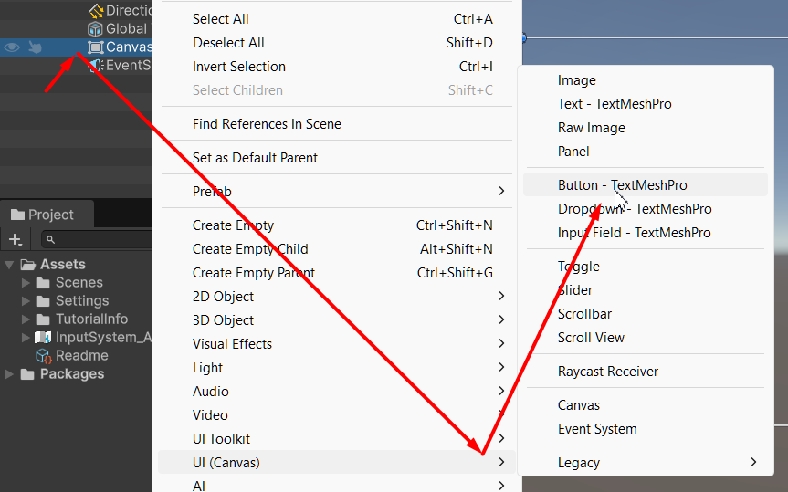
Step: 3 – Add a button
1. Right-click the canvas in the hierarchy
3. Select Button
2. Go to UI (Canvas)

Slide 8
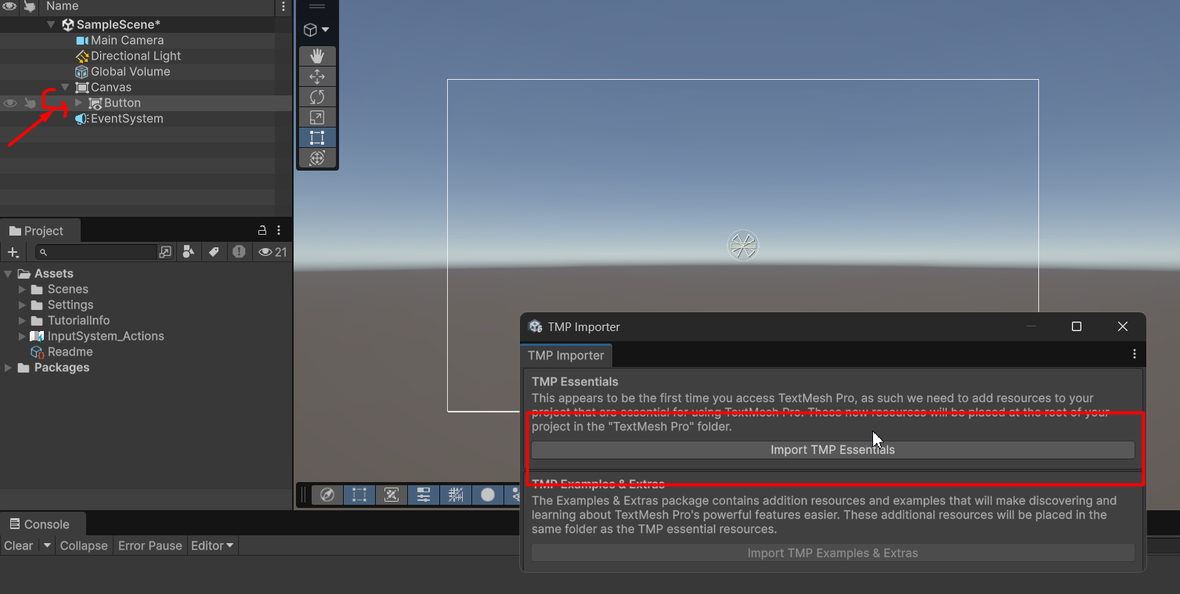
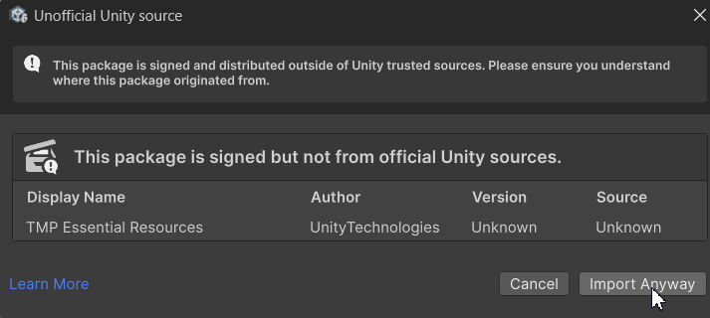
Step 4. TMP Essentials & Hierarchy setup
1. Make sure the button is a child of the canvas
2. After adding the button, this menu pops-up. Press Import TMP Essentials
3. Press import anyway.

Slide 9
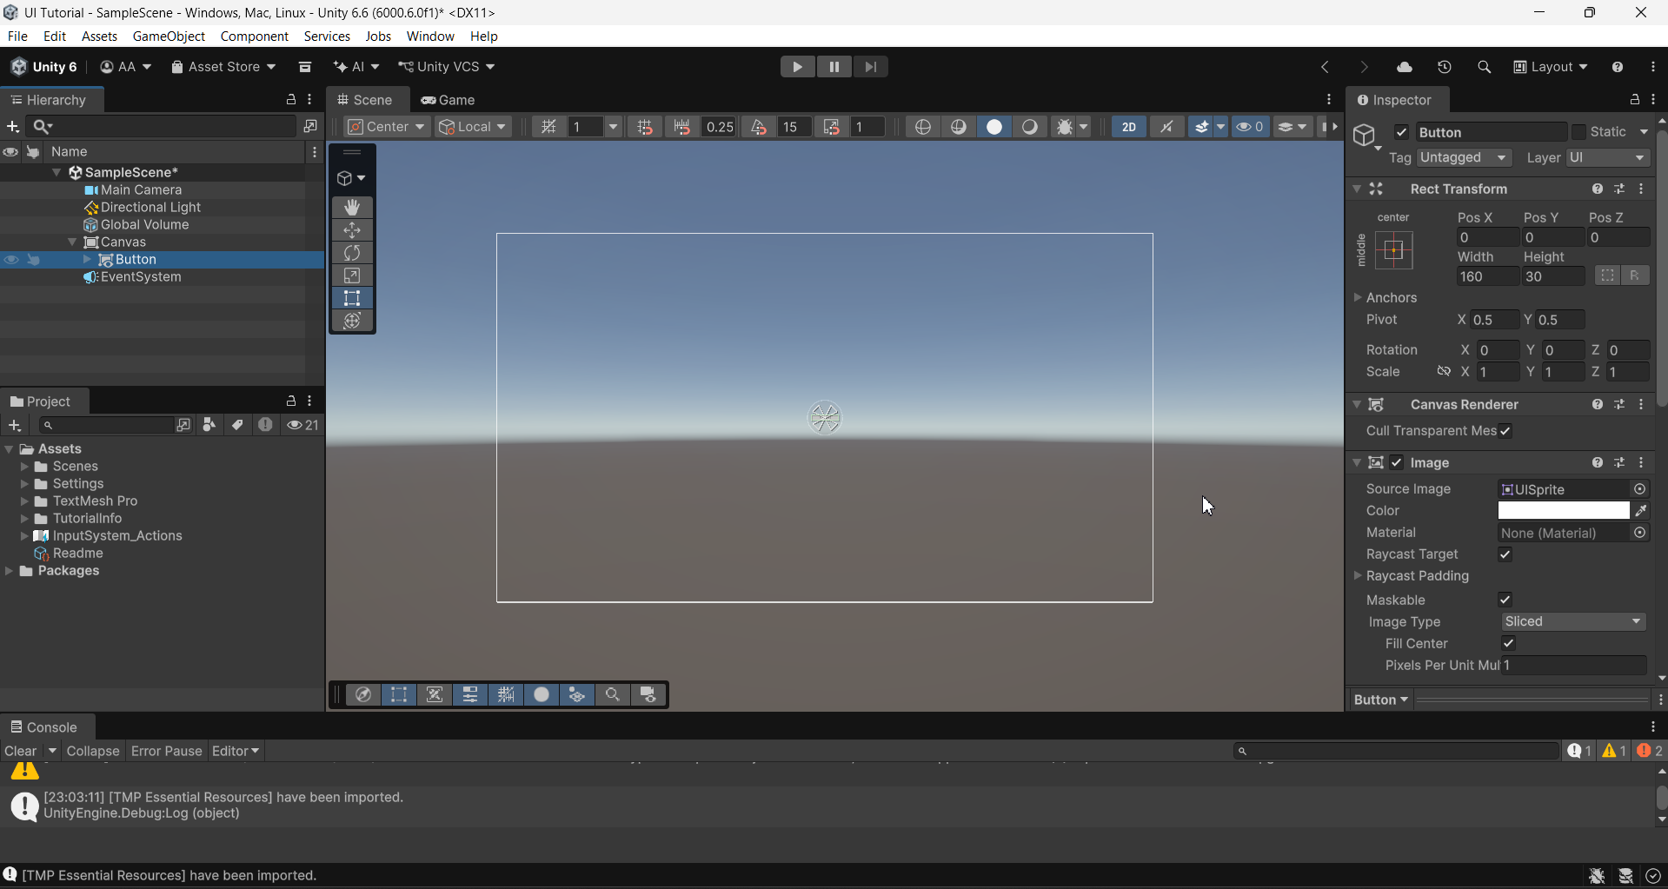
Everything should look like this

Slide 10
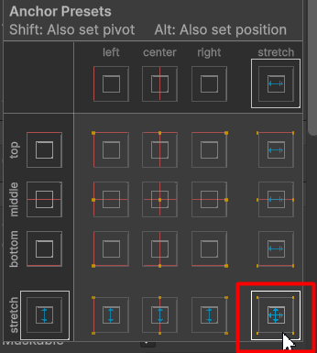
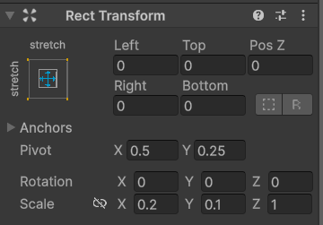

Step 5. Adjust the button
2. Select this anchor preset
3. Copy these presets.
1. Select the button in the canvas
Rect Transform explanation in the next slide;

Slide 11
Rect Transform
This is the anchor stretch mode which influences how the element scales, pivots and positions itself;
These values represent the pixel unit offset from the corresponding said side.
“Left: 100” would translate the 100px offset to the left;
You can use negative values like -100 for the opposite effect;

Slide 12
Rect Transform
Anchor pivot is used to pivot your UI element based on the stretch mode. It positions the object based on the value.
(1 = 100% / .5 = 50% / 0 = 0%)
These are Rotation and Scale
Scale sizes your element based on that value.
You can also rotate your elements via X Y Z axises;

Slide 13
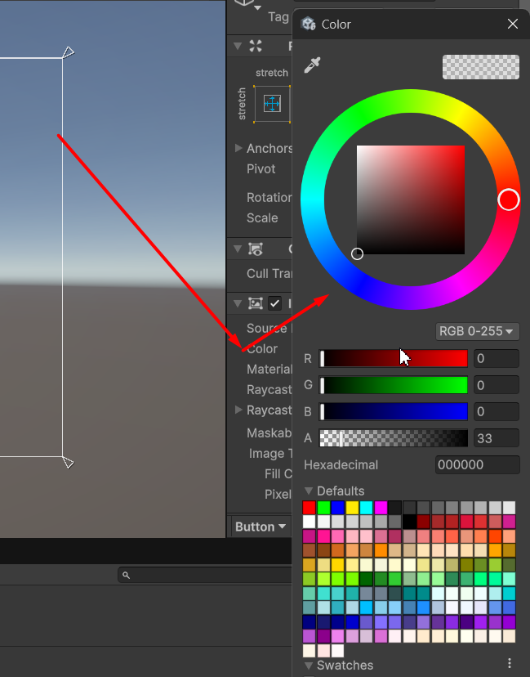
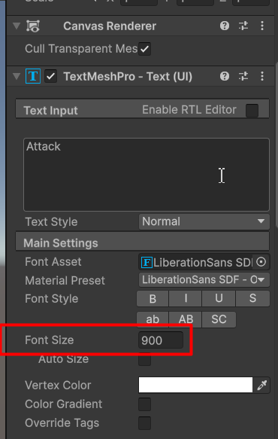

Step 6. Customize the appearance of the button
Change its color however you like; I made it full dark and 33% transparency;
Now increase its font size
Next – select the Text (TMP) in the hierarchy;

Slide 14
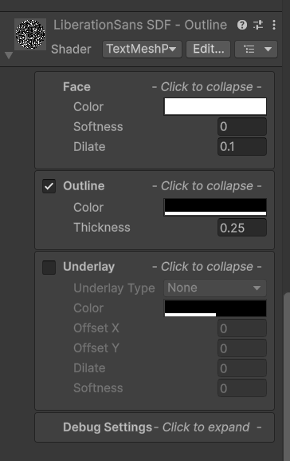
Step 6. Customize the appearance of the button
Now scroll down to font settings in the inspector and customize it however you like;
I made it the text full white and made its outline fully dark with 0.25 thickness;

Slide 15
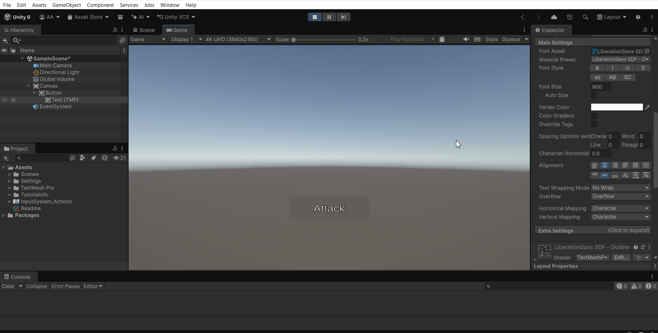
If you press play, it should look something like this

Slide 16
Let’s add a health bar now

Slide 17
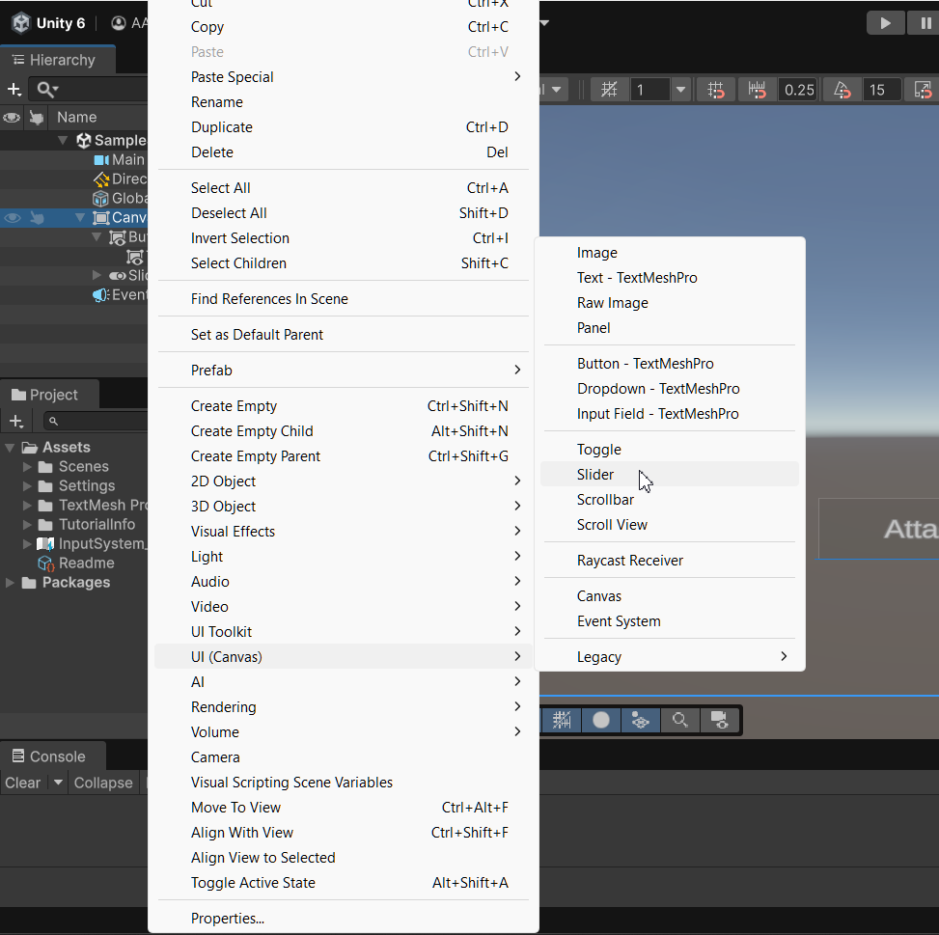
Step 7. Add a Slider
Right-click the canvas in the hierarchy
and add the slider via UI (Canvas) tab;

Slide 18
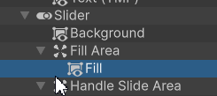
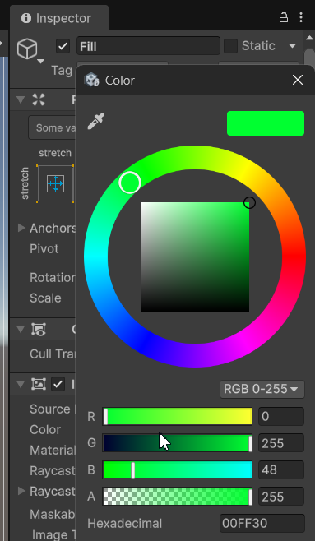

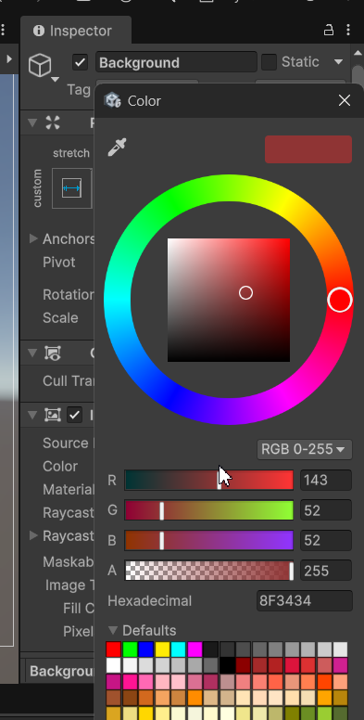
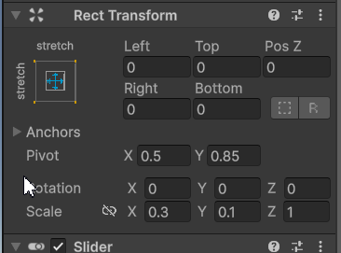
Step 8. Customize the slider
1. Select the Fill Area > Fill in the hierarchy
2. In the inspector, you can set the primary color of the health bar slider; I set it to green
3. Now select the Background in the hierarchy
4. In the inspector, you can set the health background color to whatever you like. I made it dark gray’ish red
5. Now adjust the slider position to these values

Slide 19
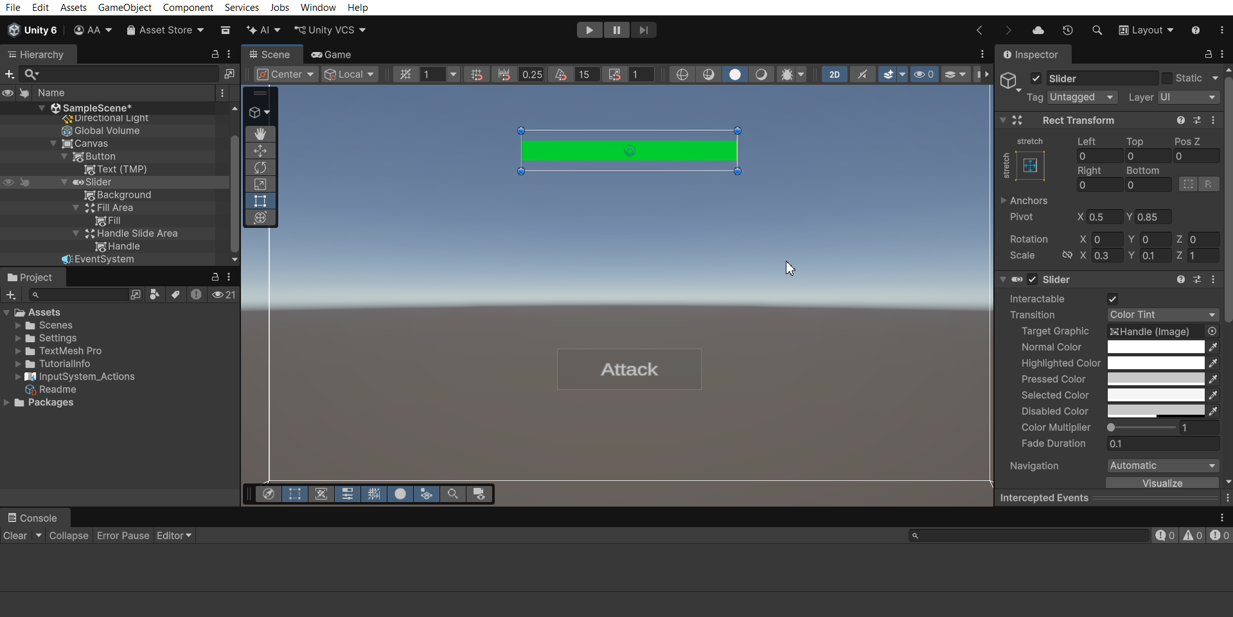
It should look something like this

Slide 20
Let’s add the HP Text inside the bar

Slide 21
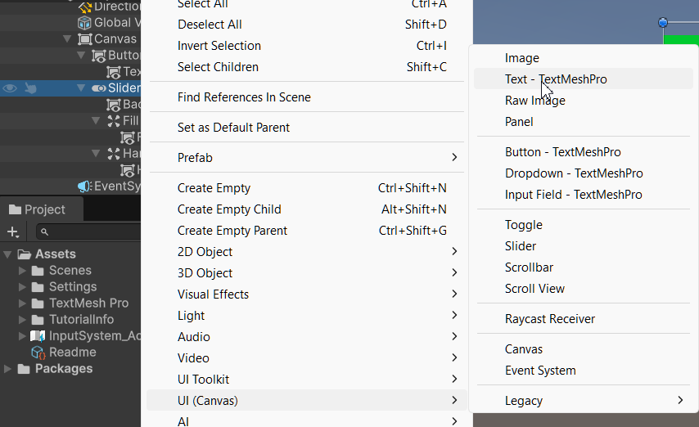
Step 9. Add the text element under the slider

Slide 22
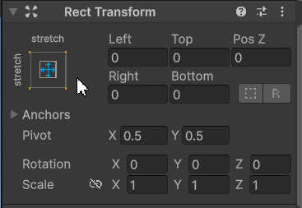
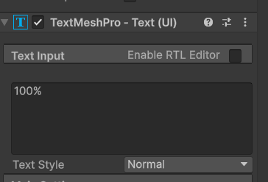
Step 10. Customize the Text
1. Selected in the hierarchy - set the stretch mode to full; all directional values to 0, pivot to 0.5 / 0.5 and keep the scale
2. Change the text to “100%” because the health bar is always going to start at full

Slide 23
Lastly, let’s add a score text;

Slide 24
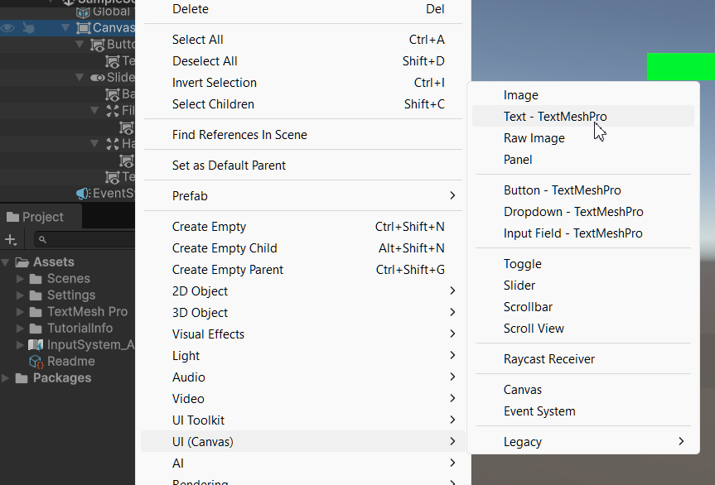
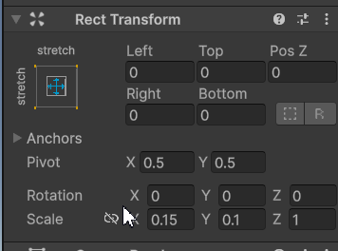
Step 11. Adding score text
Add a Text element under Canvas
In the inspector, make these rect transform values

Slide 25
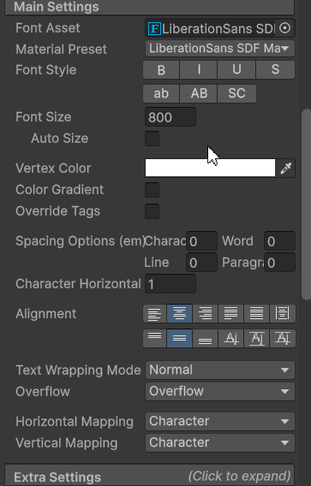
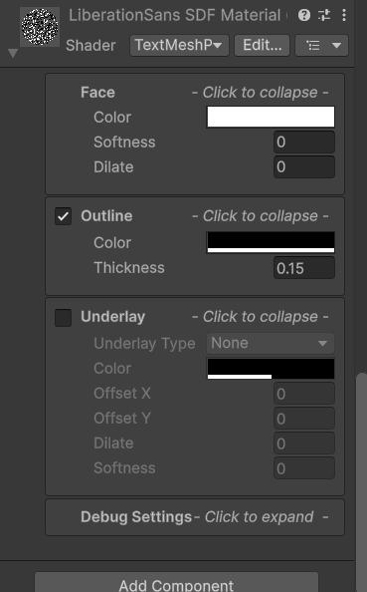
Step 12. Customize the score text
Make the font bigger and align the text in the middle
Under font settings – I added an outline

Slide 26
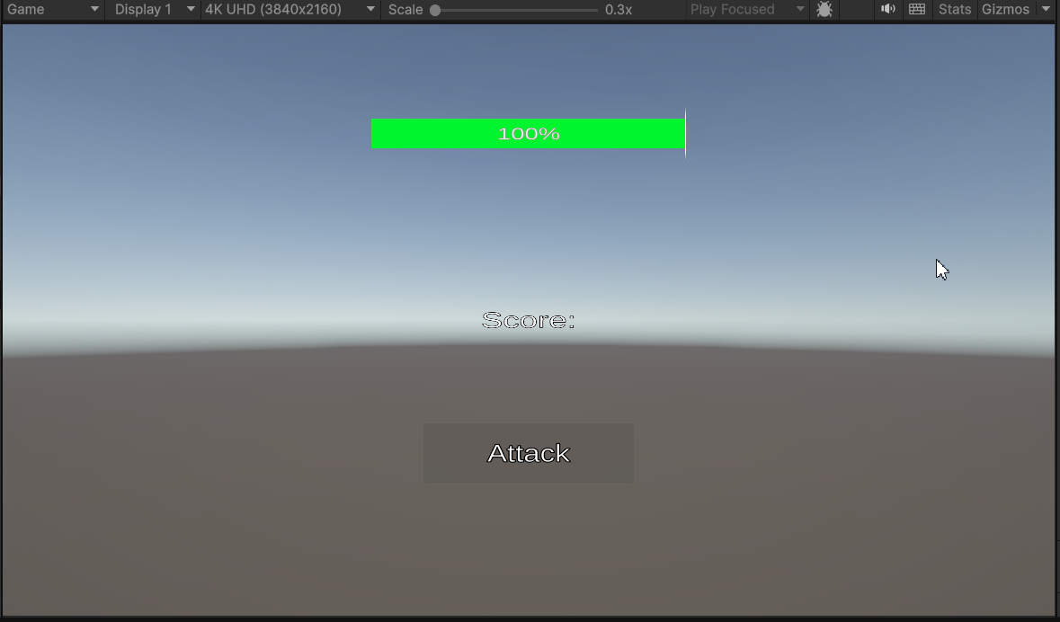
Now the game should look something like this

Slide 27
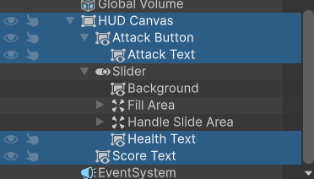
Before we continue
Organized workspace is very important; You should rename all your elements & objects to improve your workflow in the present and future without making everything more confusing;

Slide 28
Let’s begin scripting now

Slide 29
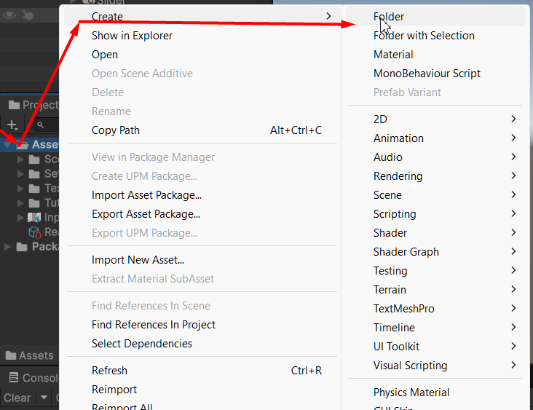
Step 13. Make a scripts folder in the project
Right-click the Assets folder in the Project tab and create a new folder and call it “Scripts”

Slide 30
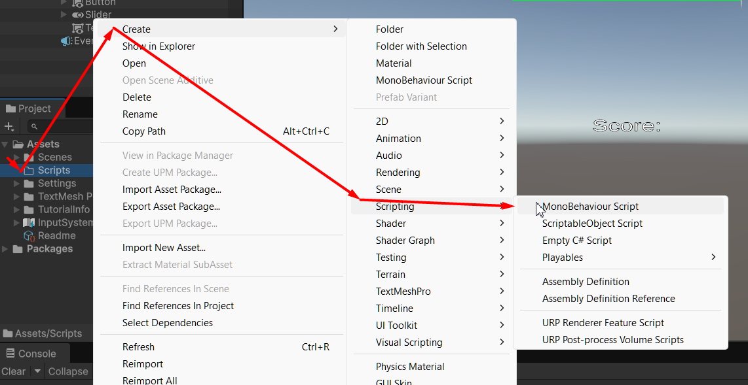
Step 14. Create a new script
Right-click the Scripts folder in the Project tab and create a new MonoBehaviour Script
After that you can rename to script to whatever you like, but I’ll call it: “AttackMenu”

Slide 31
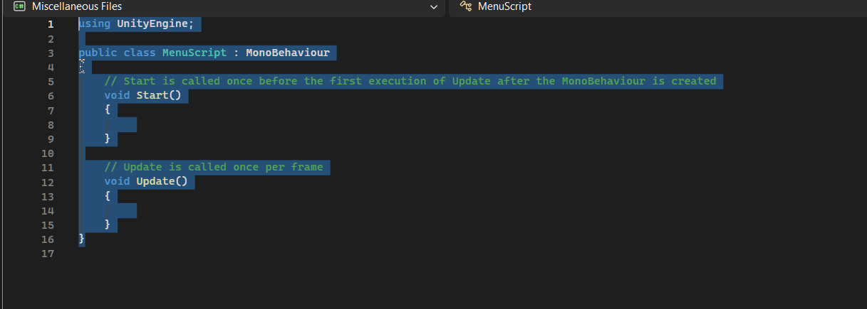
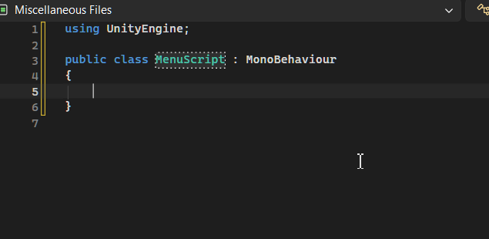
Step 15. Editing the script
Delete Start() and Update() functions inside the script;

Slide 32
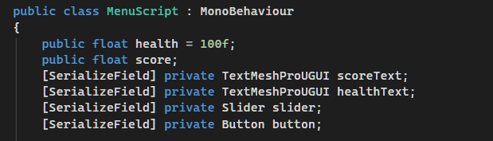
Step 16. Making the game script
Add these variables
We use public on score and health just in case, because they’re generic and important variables that might be accessed by other scripts;
And we use private on objects with SerializeField, because we only need to reference them for visual purposes in this case.

Slide 33

Step 17. Include more namespaces
Additionally include UnityEngine.UI so you can reference Button & Slider elements
And include TMPro to reference TextMeshPro (text) objects

Slide 34
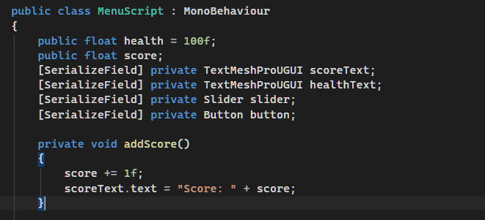
Step 18. Adding score
Now let’s add a addScore() function
Lets make it increment the score up by 1 and update the score text
The function is private, because it will only be used internally and it’s a void, because it won’t return anything.

Slide 35
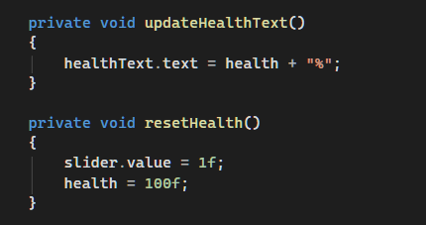
Step 19. Health functions
Next we make 2 more functions that are private, because they’re only going to be used within the code;
Void, because they do not return a value, but instead complete a function;
updateHealthText() will change the health object text to the current health variable value and add a “%” at the end
resetHealth() will simply reset the healthbar slider to full and health value back to 100

Slide 36
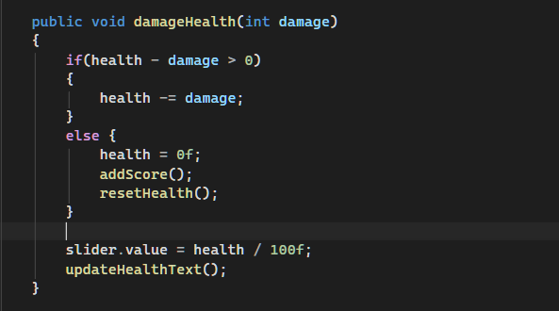
Step 20. Final Damage function
For the last main function we will make it public so it can be accessed by the button we’re going to click, and we receive the damage number (int damage);
This part makes sure that the health doesn’t go in to the negatives;
If health is below or equal to 0, it will reset the health back to 100%, including the visual health bar slider & and adds 1 score
This part updates the actual health bar visual (slider) based on current health divided by max health (right now, by default max health is 100, but you can make a variable for it)
And lastly we update the % health text inside the health bar

Slide 37
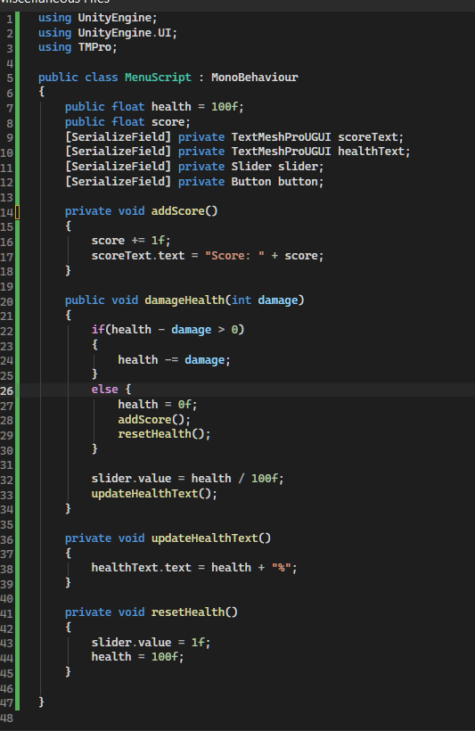
How the script should look:

Slide 38
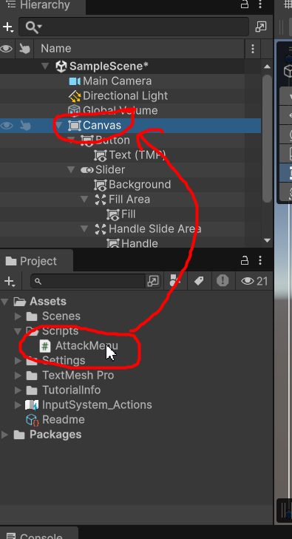
Step 21. Assign the script to the main canvas
Drag the script onto the canvas to attach it

Slide 39
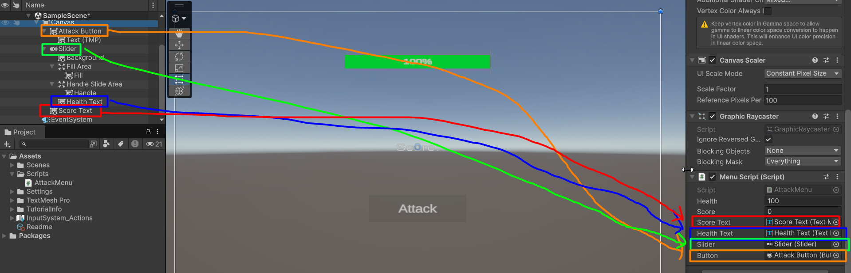
Step 22. Referencing objects
Drag all the corresponding elements to their places

Slide 40
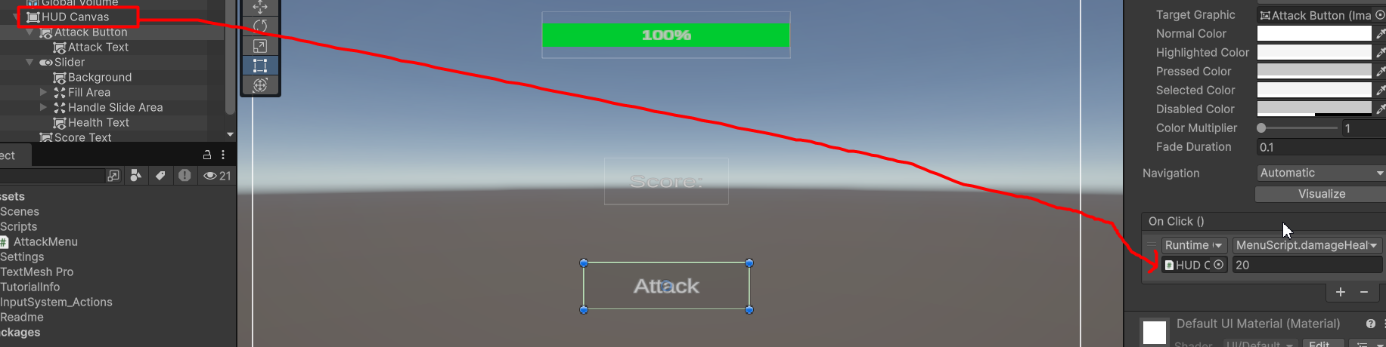
Step 23. Adjusting Button References
1. Select the Attack Button in the hierarchy
2. Drag the Canvas onto the On Click {} function panel

Slide 41
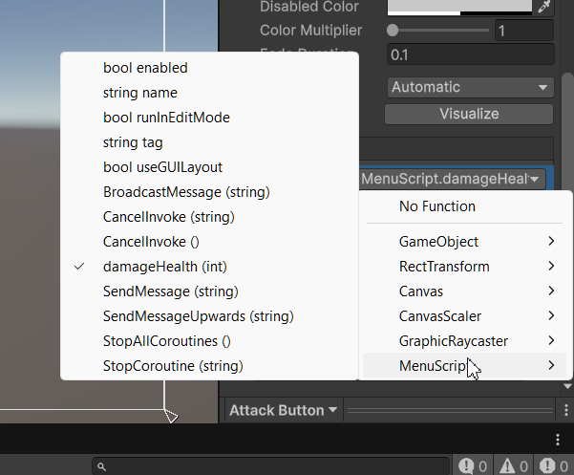
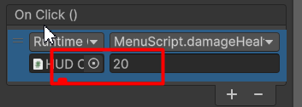
Step 24. Button functionality
1. Click on the functions > Select MenuScript > damageHealth (int)
2. Assign the damage dealt value to whatever you want, I chose 20

Slide 42
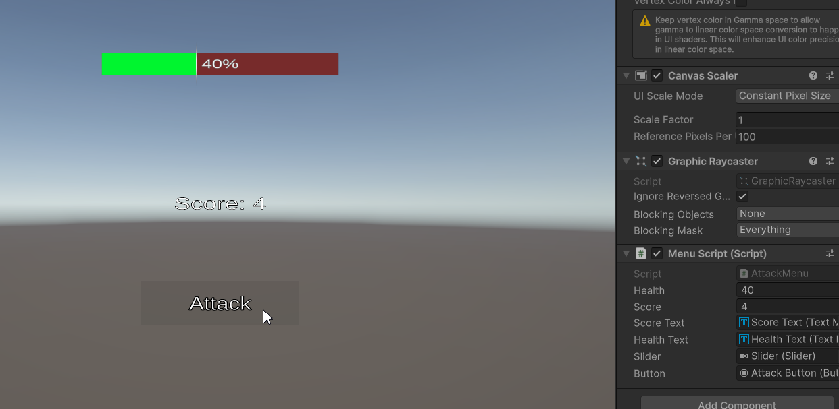
The game should work now

Slide 43
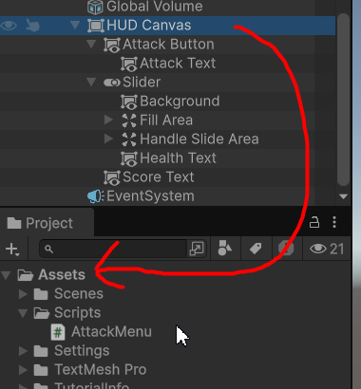
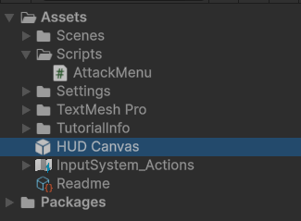
Step 25. Turn the HUD into a prefab
Simply select the HUD Canvas and drag it into the Assets folder;
This will automatically make it a prefab;

Slide 44
That’s it. Thank you for following my tutorial.

